Slide 2
Inside Scoop: Behind the Scenes
With the Education Committee
Speakers:
Moe Bouayad of Crown Worldwide
Erica Bugbee of ExecuStar World Class
Sarah Mercer of NLA
Doug Schwartz of Executive Transportation
Jason Sharenow of Broadway Elite
Scott Woodruff of Majestic Limo & Coach
AV Sponsor
Coffee Sponsor

Slide 3
Welcome & Thank You
to Our Sponsors
AV Sponsor
Coffee Sponsors

Slide 4
Inside Scoop: Behind the Scenes
of the Education Committee
AV Sponsor

Slide 5
Goals of the Education Committee
When Planning the Educational Program
Reviewing feedback from previous show surveys, social media, etc.
Identifying topics that are timely and relevant to attendees
Considering various perspective on topics to create well-rounded sessions
Planning sessions that will appeal to a wide demographic
Bringing in outside expertise for sessions
Securing new speakers who have not participated in previous programs
AV Sponsor

Slide 6
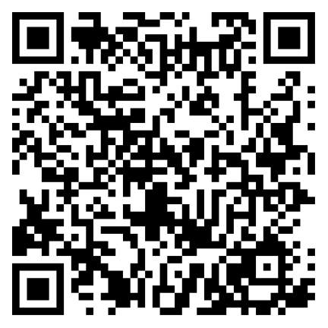
Share Your Thoughts for the Upcoming CD/NLA Show!
The Committee is already working on the 2025 CD/NLA Show in Las Vegas and they want to hear from YOU!
Scan the QR code to
share your suggestion!
AV Sponsor

Slide 7
A Sneak Peek at Potential
2025 CD/NLA Show Topics
Building Rates for Service
Corporate Travel
Diversification of Business
Economic Projections Post-Election
Mental and Physical Wellness
Remote Employees/Managing Multiple Locations
Working with Independent Operators (IOs)
Taxes
AV Sponsor

Slide 8
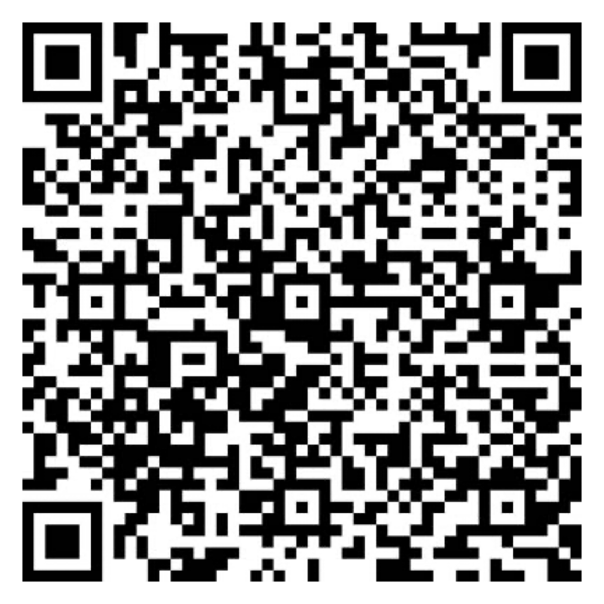
Let Us Know How
We Did!
Fill Out the Survey
AV Sponsor
Coffee Sponsor

Slide 9
Thank You for Joining Us!
AV Sponsor
Coffee Sponsor

